Slide 1
Lesson Objectives
After completing this lesson, you will be able to:
Explain basic concepts of a database.
Two different ways to create a database.
Work with records in a database.
Explain what database queries are and how they work.
Work with reports

Slide 2
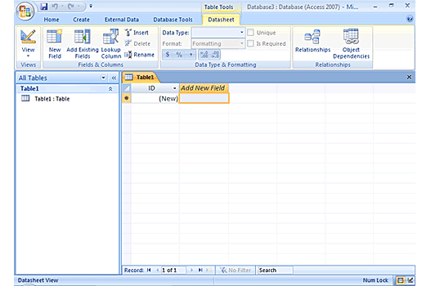
Overview of Access
A database contains objects that store, edit, and format information. Data is organized in a database in the form of tables.
Two common types of databases Flat file and Relational.
Flat file: database contains all the data in a single table,
Relational: database stores data in multiple tables.
Notes:
Overview of Microsoft Access
Suppose you own a business and you want to keep track of accounts, inventory, and employees. This information is too large to be managed with simple spreadsheets. A database is the best way to manage all this information.
A database contains objects that help you to store, edit, and format information. Data is organized in a database in the form of tables. Two common types of databases are flat file and relational. A flat file database contains all the data in a single table, whereas a relational database stores data in multiple tables.
In relational databases, you can store data in categories using multiple tables. For example, you can keep all the basic contact information of a customer in one table, the products they buy in another, and credit data in another. You can create a link between these three tables by using a common field, such as Customer ID, contained in all the three tables. You can use the database to create a mailing list of all the customers who have bought items from you. You can then send sale brochures to the customers. The database assembles the appropriate data from the tables to give you the information as a single report.
To create databases, establish relationships among multiple tables, and retrieve information, you use a database program, such as Access 2007. A database program helps you perform various functions on the information stored in a database and displays the results in a desired format. For example, you can easily generate a report of the total and average sales of 50 products in five areas by using a query. A query is a database object that enables you to locate the desired information within a database.

Slide 3
Access Objects
Tables: - a collection of data about a topic arranged in rows and columns.
Forms: - a place to enter data easily
Queries: - a tool that lets you view, change, and analyze data in different ways
Reports: - a method to present your data in a printed format, such as charts & invoices
Notes:
Read and discuss each bulleted item as it appears.
Access Objects
Tables: - a collection of data about a topic arranged in rows and columns.
Forms: - a place to enter data easily
Queries: - a tool that lets you view, change, and analyze data in different ways
Reports: - a method to present your data in a printed format, such as charts & invoices

Slide 4
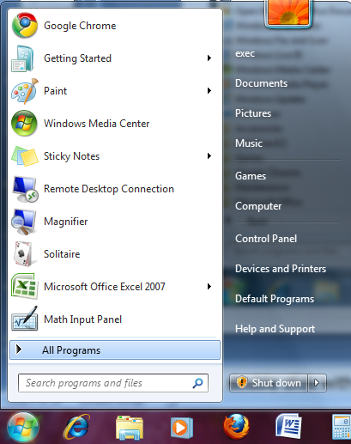
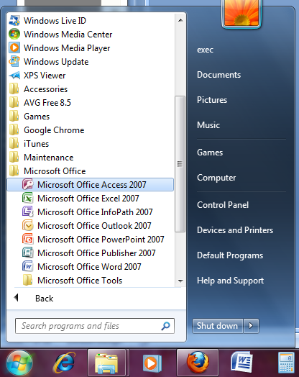

Create a Database
click the Start button, and then click All Programs
click Microsoft Office, and then click Microsoft Office Access 2007
Notes:
Read each bulleted item

Slide 5
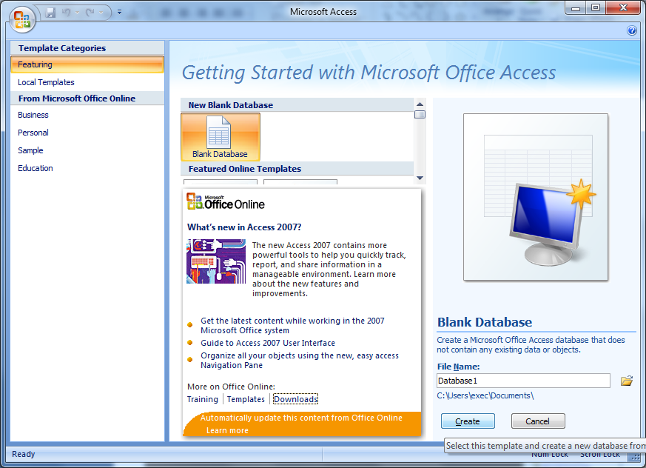
Create a Database (cont.)
Click Blank Database. Type a name for your database in the File Name Box.
Notes:
Click in the circle to choose a Blank Database and click OK

Slide 6
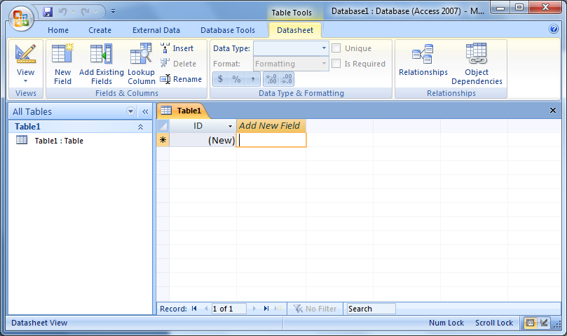
Create a Database
Create a Database (cont.)
To create fields for the table, double click the Add New Field cell, type First Name and press the ENTER key.

Slide 7
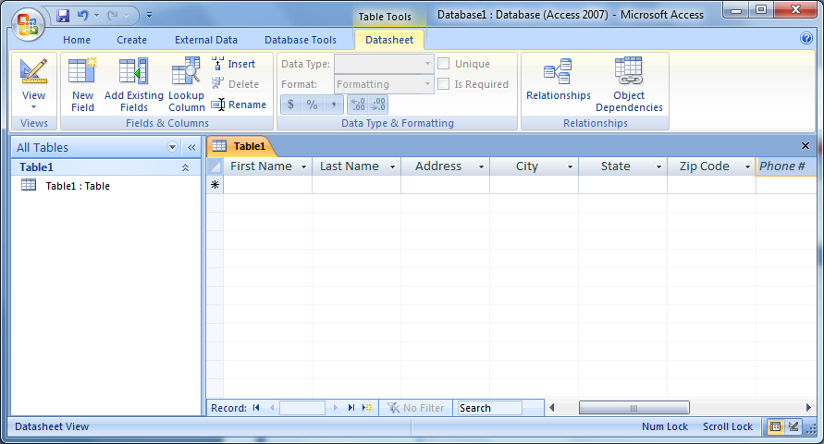
Create a Database (cont.)
To add data to the table, type in the data in each field cell.

Slide 8
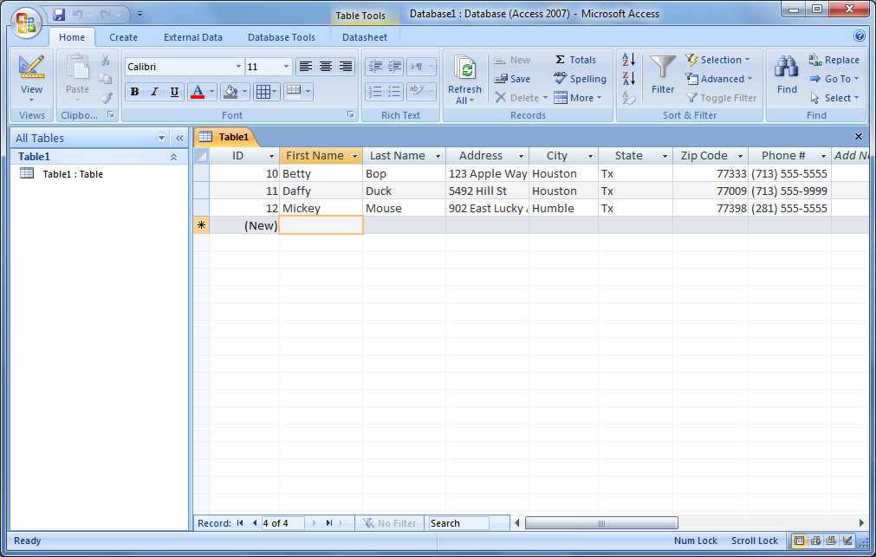
Entering data
Create a Database (cont.)
Entering Data
Notes:
We’re going to enter some data into the Table.
Click in the first record, the top most left cell, to select it.
Type in the text Last Name. Press ENTER.
Notice that the cursor moves to the next cell.
Click on the down arrow in the Data Type cell.

Slide 9
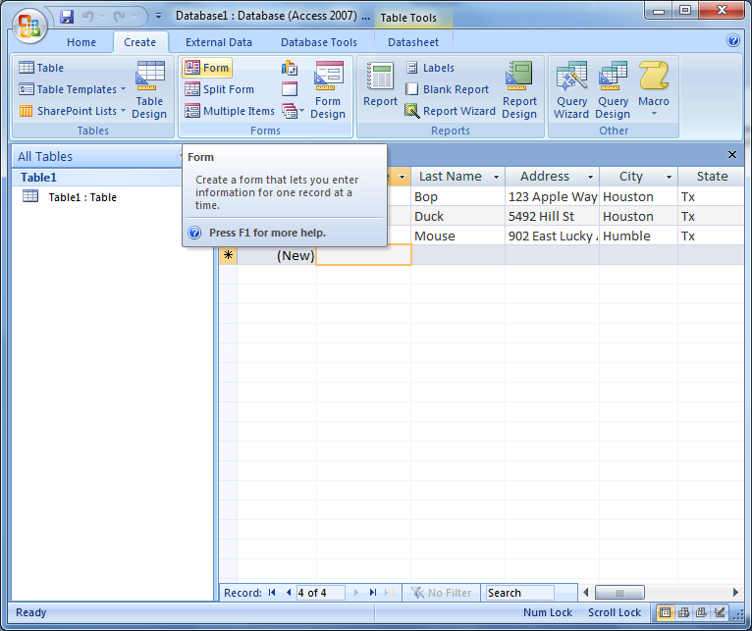
Creating Forms
To create a form from a table, click on the Form icon from the Create tab.

Slide 10
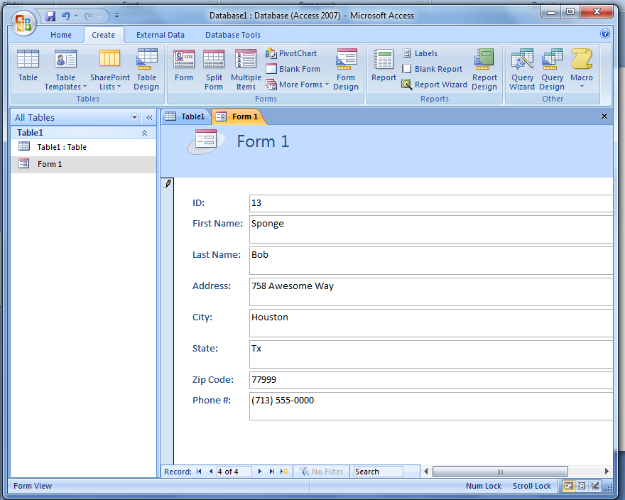
Creating Forms (cont.)
Entering Data
Notes:
Let’s open the Table our Form was based on.
Point out the data that now appears in our table.

Slide 11
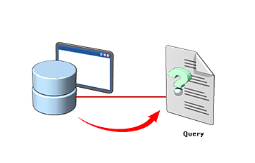
Database Queries
You use a query to retrieve specific information from a database.
A query is a question that you enter in a database program.
The database program then performs the required operations to present the answer in the form of a report.
A query helps you view specific data to modify or analyze it.
Notes:
You use a query to retrieve specific information from a database. A query is a question that you enter in a database program. The database program then performs the required operations to present the answer in the form of a report. A query helps you view specific data to modify or analyze it.Suppose you own a bakery. You store detailed information about your customers in a Customer table and data about the sales of all the products in a Product table in a database.You now want to know which flavor of pastries is less popular in the area with postal code 97001 so that you can introduce a special offer on the less popular flavor to increase its sales. You can use a query to retrieve sales details to help you make this decision.You then select the tables from which you want to search data. The common fields in the tables are shown as connected.Queries work on search conditions called filters to retrieve specific information from a database. You can specify the fields on which you want to base your query in the Criteria field, such as postal code.You can also drag other fields that are a part of the query. You can clear the boxes in the Show field for the fields you do not want to view in the report.The result of the query appears as a report. This report contains the sales details of all the pastry flavors sold in the area with the postal code 97001.A database program also allows you to sort the displayed information on the basis of a specific field. For example, you can arrange the results of the query on the basis of the pastry flavor.
You use a query to retrieve specific information from a database. A query is a question that you enter in a database program. The database program then performs the required operations to present the answer in the form of a report. A query helps you view specific data to modify or analyze it.
Suppose you own a bakery. You store detailed information about your customers in a Customer table and data about the sales of all the products in a Product table in a database.
You can use a query to retrieve sales details to help you make this decision.
You then select the tables from which you want to search data. The common fields in the tables are shown as connected.
Queries work on search conditions called filters to retrieve specific information from a database. You can specify the fields on which you want to base your query in the Criteria field, such as postal code.
You can also drag other fields that are a part of the query. You can clear the boxes in the Show field for the fields you do not want to view in the report.
The result of the query appears as a report. This report contains the sales details of all the pastry flavors sold in the area with the postal code 97001.
A database program also allows you to sort the displayed information on the basis of a specific field.

Slide 12
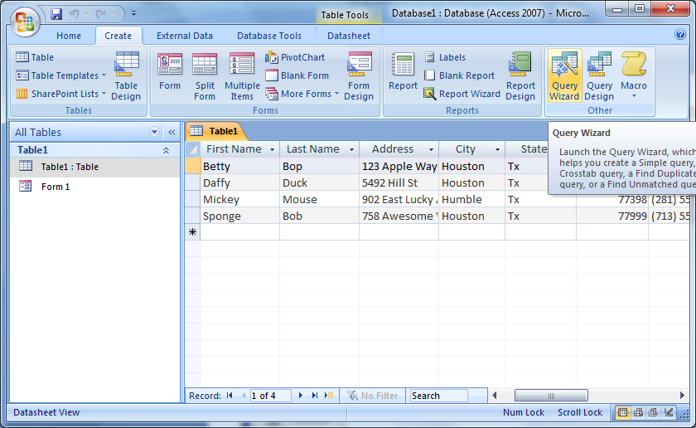
Creating Queries
To create a query, click the Create tab. In the Ribbon, click Query Wizard.

Slide 13
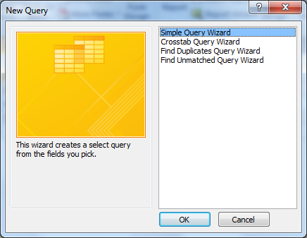
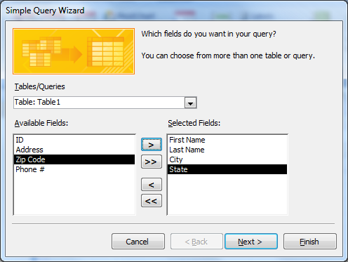
Creating Queries (cont.)
When the New Query window appears, make sure Simple Query Wizard is selected.
Transfer data from the Available Field to the Selected Field one at a time using >
Notes:
Click on the Query tab and click New.

Slide 14
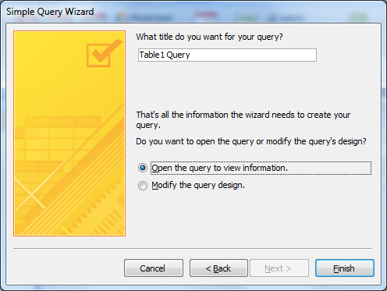
Creating Queries (cont.)
When the final screen appears, type the Names of the query
Notes:
We need to choose the Fields that we want to include in our Query and what Table the data will come from.
Select the Fields Last Name and State. Click the single arrow to move them to the Selected Fields box.
Click <Next>

Slide 15
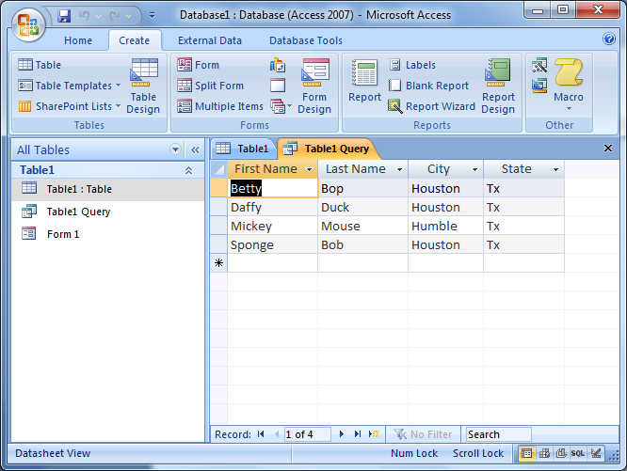
Click the button.
.
Creating Queries (cont.)
The query is automatically saved and executed.
Notes:
The screen shows the Fields that we have selected.

Slide 16
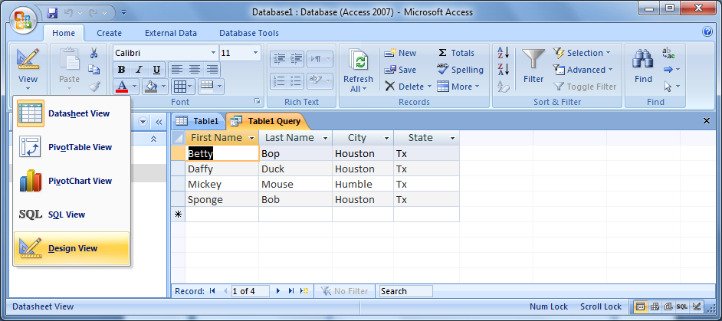
Creating Queries (cont.)
Notes:
Let’s name our Query as Gates Access Training Query. Type it in the box.
Click in the circle next to “Open the query to view…” to select it.
Click <Finish>

Slide 17
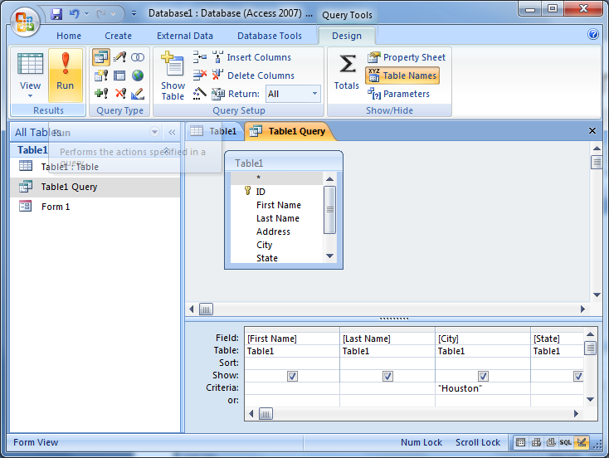
Creating Queries (cont.)
Notes:
Let’s name our Query as Gates Access Training Query. Type it in the box.
Click in the circle next to “Open the query to view…” to select it.
Click <Finish>

Slide 18
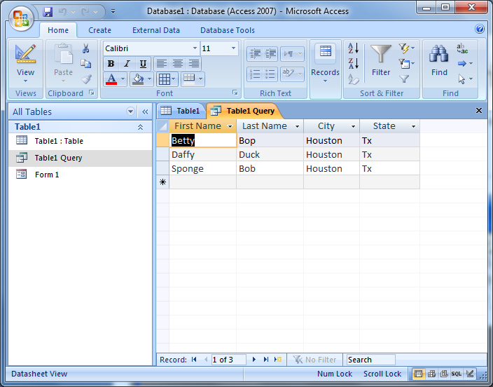
Creating Queries (cont.)
Notes:
Let’s name our Query as Gates Access Training Query. Type it in the box.
Click in the circle next to “Open the query to view…” to select it.
Click <Finish>

Slide 19
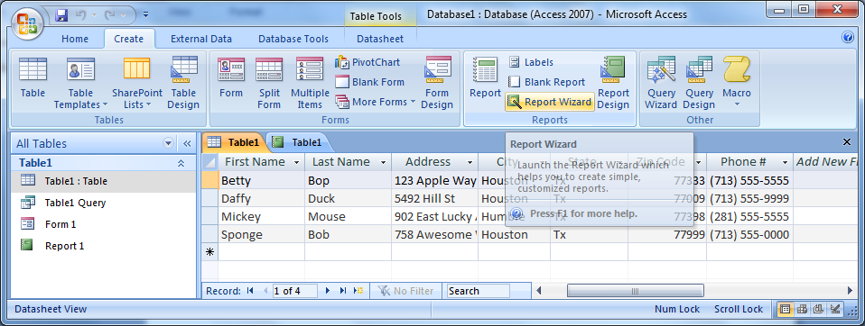
Working with Reports
To create a report by using the Report Wizard, click the Create tab, and in the Reports group, click Report Wizard.
Notes:
Working with Reports
Step 1 To create a report by using the Report Wizard, on the Ribbon, click the Create tab
.
Step 2 On the Create tab, in the Reports group, click Report Wizard.
Step 3 To select the required fields for the report, in the Report Wizard, on the Which fields do you want on your report? page, click the Add button (>>), and then click Next.
Step 4 To group the records in the report by Product ID, on the Do you want to add any grouping levels? page, click the > button.
Step 5 To modify the grouping option, click Grouping Options.
Step 6 In the Grouping Intervals dialog box, click OK.
Step 7 On the Do you want to add any grouping levels? page, click Next.
Step 8 To sort the records by Quantity, on the What sort order and summary information do you want for detail records? page, in the first list, click the arrow, click Quantity, and then click Next.
Step 9 To select the outline layout for the report, on the How would you like to lay out your report? page, under Layout, click Outline, and then click Next.
Step 10 To select a style for the report, on the What style would you like? page, click Flow, and then click Next.
Step 11 To complete the report, on the What title do you want for your report? page, click Finish.
Step 12 To close the print preview,, in the Close Preview group, click Close Print Preview.

Slide 20
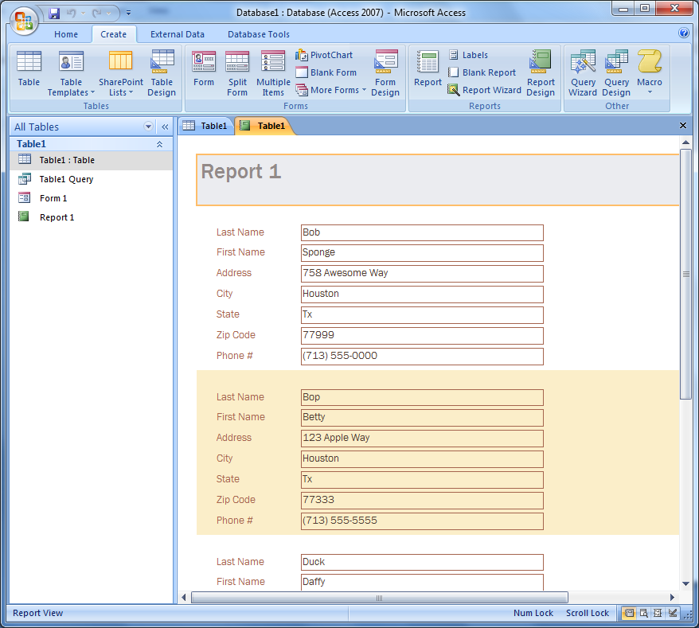
Working with Reports

